Slide 1

National University of Computer and Emerging Sciences
Advanced Generative Adversarial Networks
AI-4009 Generative AI
Dr. Muhammad Nouman Noor
Department of Artificial Intelligence & Data Science

Slide 2
Goals
Today’s Lecture
CycleGANs
Pix2Pix
CycleGANs
StyleGANs
BigGANs
WGANs
Superresolution GAN (SRGAN)

Slide 3
Today’s Lecture

Slide 4
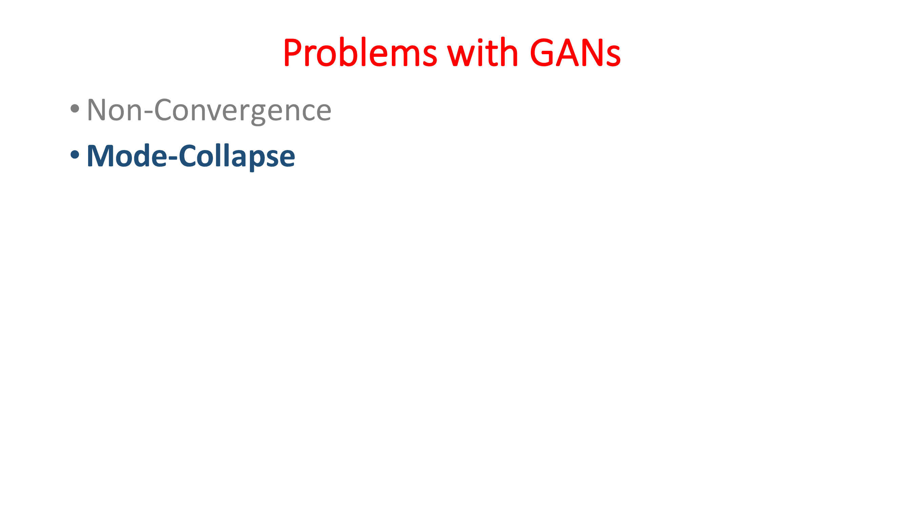

Slide 5
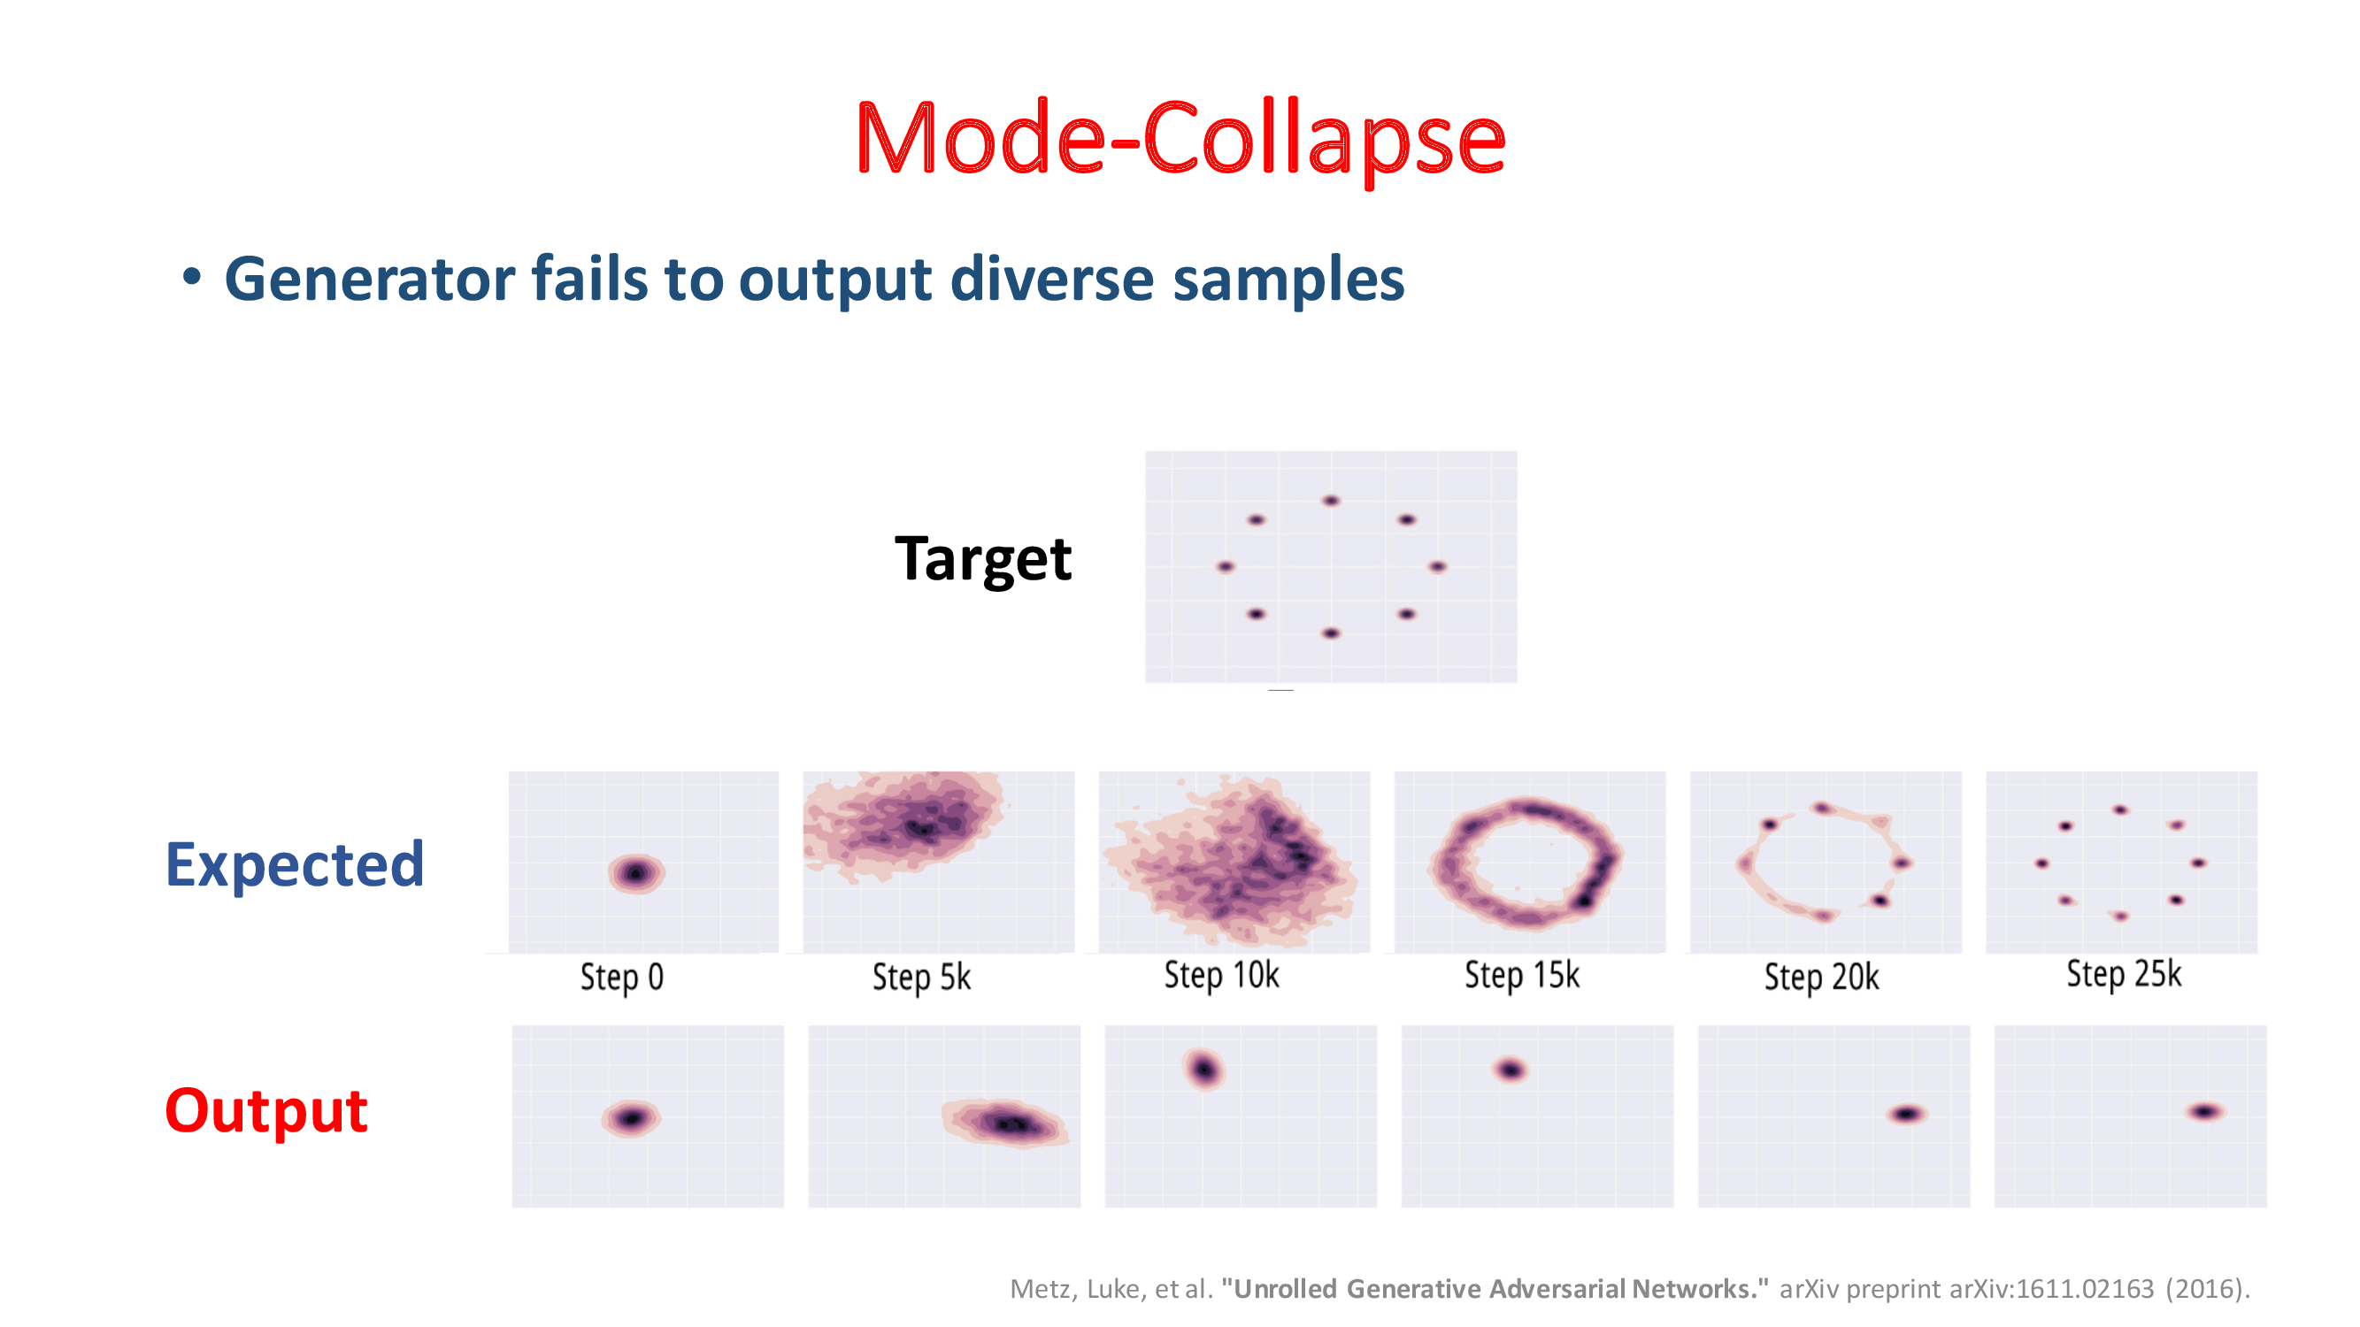

Slide 6
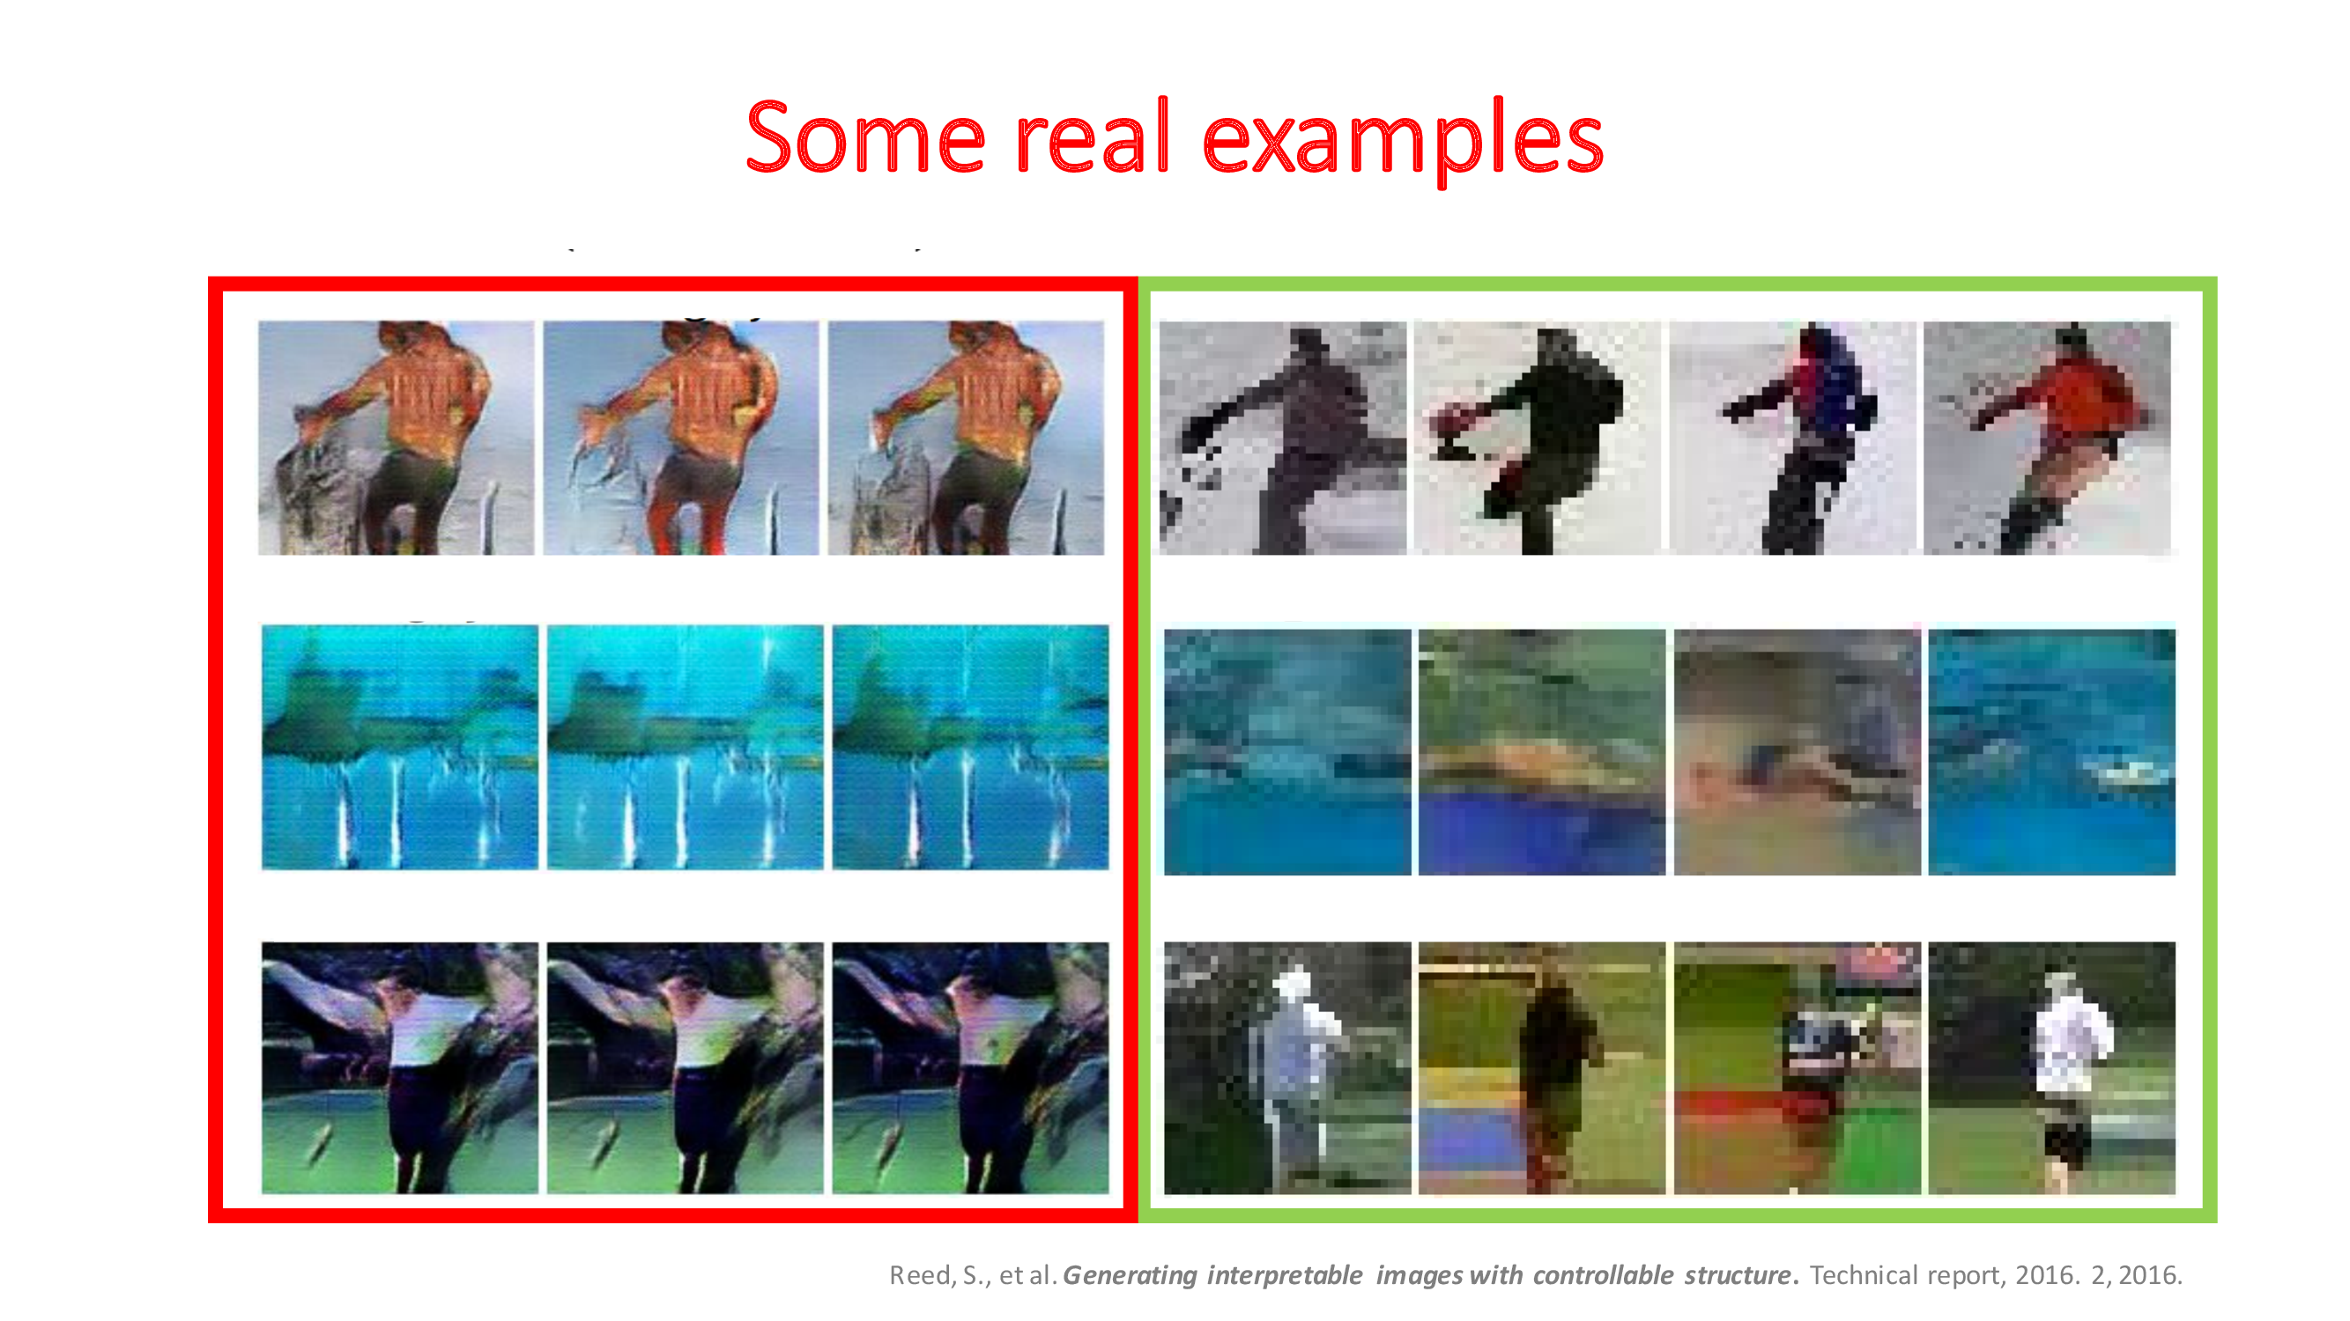

Slide 7
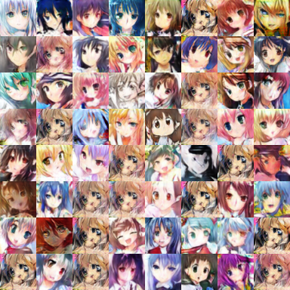
Mode Collapse
Converge to same faces
Generated Distribution
Data Distribution
Sometimes, this is hard to tell since
one sees only what’s generated, but not what’s missed.

Slide 8
Solutions
Use Mini Batch GANs
Supervision with Labels

Slide 9
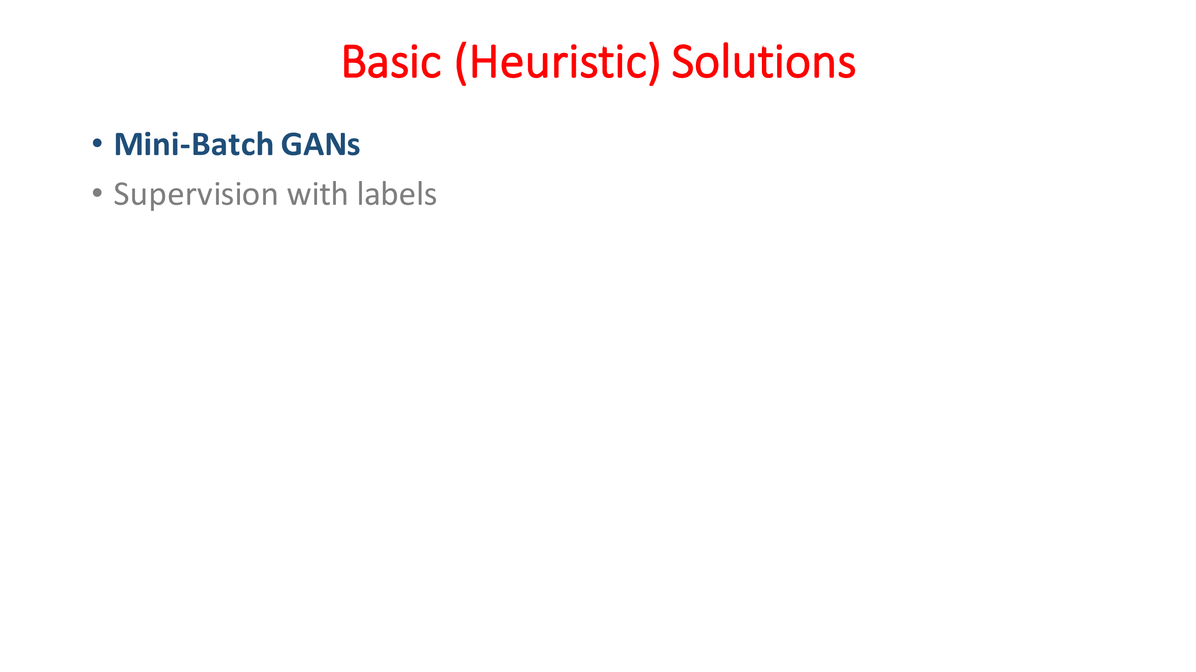

Slide 10
Mini Batch Generative Adversarial Networks (Mini Batch GANs)
Mini Batch GANs are a variation of Generative Adversarial Networks (GANs).
In traditional GANs, the discriminator evaluates each sample individually to decide whether it is real or fake.
In Mini Batch GANs, the discriminator evaluates samples in small groups or "mini-batches".
Concept called mini-batch discrimination
Assess the authenticity of individual samples but also the diversity between samples within a batch.

Slide 11
Mini Batch GANs on MNIST
Deconv
Tanh/Sigmoid
Conv, BN,
LReLU
Conv, BN,
LReLU
Reshape,
FC, BN,
LReLU
FC,
Sigmoid
FC, BN,
Reshape
Deconv
BN, ReLU
100
7x7x16
14x14x8
28x28x1
14x14x8
7x7x16
256
1
Generator
Discriminator

Slide 12
Mini Batch GANs
Generator in Batches
The generator can produce batches of images at once instead of single images.
Processing in batches allows for more efficient computation.
More diversity of samples being evaluated by the discriminator, facilitating a more comprehensive training.
Mini-batch Discrimination
The discriminator uses a measure to assess how much the generated samples deviate from the real samples within the same batch.
Computing distances or similarities between samples in the feature space.
How diverse the generated images are within each batch (mode collapse).

Slide 13
Mini Batch GANs
Backpropagation:
Based on the discriminator’s feedback the GAN updates both the generator and discriminator.
The generator learns to produce more diverse and realistic samples
Iteration:
This process repeats over many cycles
The generator and discriminator iteratively improving in response to each other's feedback.

Slide 14

Mini Batch GANs
For standard Discriminator in GAN:
$$L_{D}=−\frac{1}{N}\sum_{i=1}^{N}{\left[y_{i}\log\left(D\left(x_{i}\right)\right)+\left(1−y_{i}\right)\log\left(1−D\left(G\left(z_{i}\right)\right)\right)\right]}$$
For Generator:
$$L_{G}=−\frac{1}{N}\sum_{i=1}^{N}{\log\left(D\left(G\left(z_{i}\right)\right)\right)}$$

Slide 15
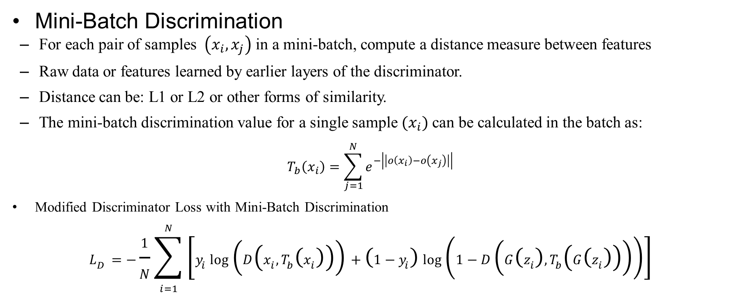
Mini Batch GANs
Mini-Batch Discrimination
For each pair of samples $\left(x_{i},x_{j}\right)$ in a mini-batch, compute a distance measure between features
Raw data or features learned by earlier layers of the discriminator.
Distance can be: L1 or L2 or other forms of similarity.
The mini-batch discrimination value for a single sample $(x_{i})$ can be calculated in the batch as:
$$T_{b}\left(x_{i}\right)=\sum_{j=1}^{N}{e^{−\left|\left|o\left(x_{i}\right)−o\left(x_{j}\right)\right|\right|}}$$
Modified Discriminator Loss with Mini-Batch Discrimination
$$L_{D}=−\frac{1}{N}\sum_{i=1}^{N}{\left[y_{i}\log\left(D\left(x_{i},T_{b}\left(x_{i}\right)\right)\right)+\left(1−y_{i}\right)\log\left(1−D\left(G\left(z_{i}\right),T_{b}\left(G\left(z_{i}\right)\right)\right)\right)\right]}$$

Slide 16
Advantages of Mini Batch GANs
Mini Batch GANs encourage the generator to produce a diverse range of outputs.
Stable training as the discriminator works on a batch instead of individual samples.
Mini batches can lead to faster convergence of the network
Mini-batch discrimination provides more information to the generator, which can help in generating higher-quality samples.

Slide 17
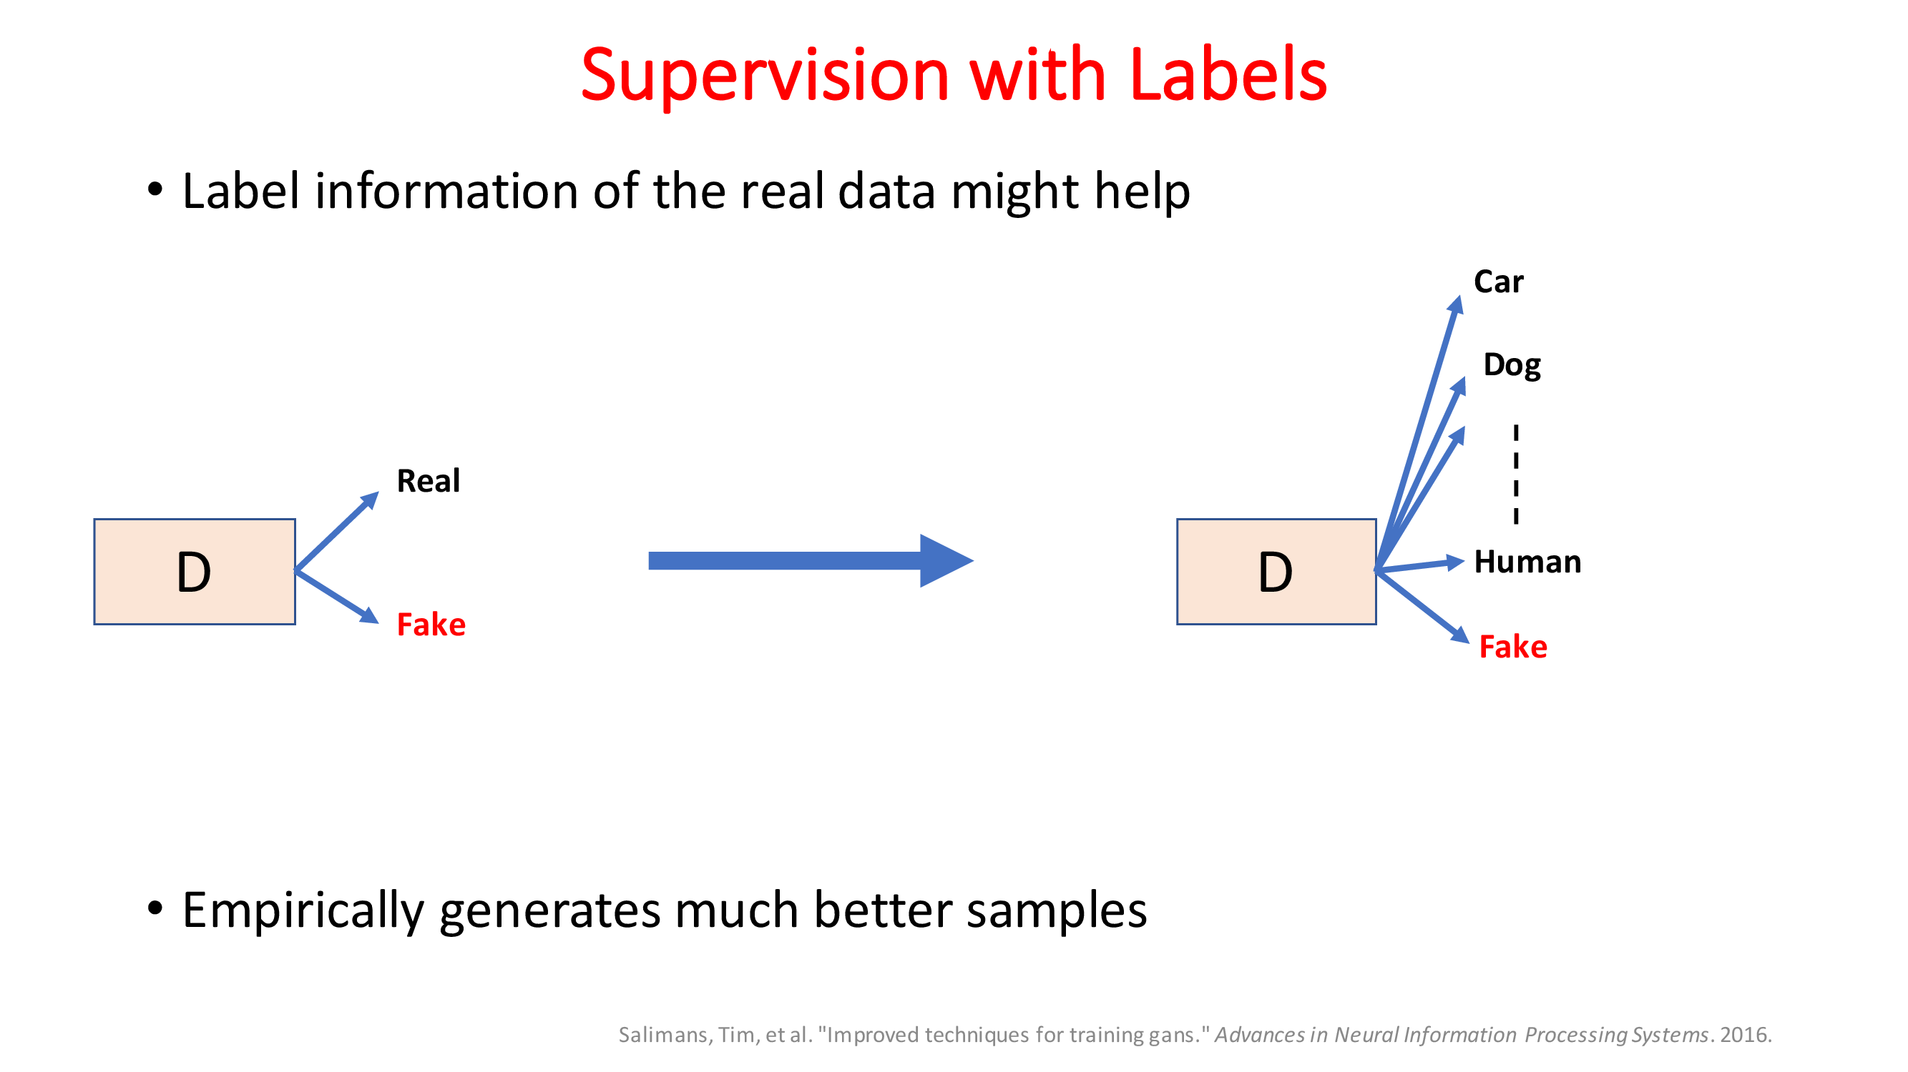

Slide 18
Unsupervised Representation Learning with Deep Convolutional Generative Adversarial Networks

Slide 19
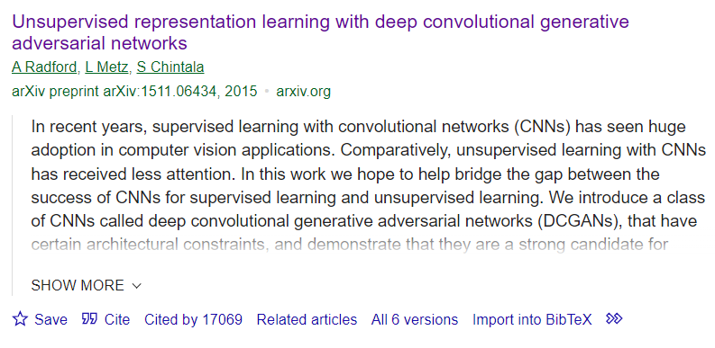
DCGAN

Slide 20
DCGANs
DCGAN: Download Paper.
Supervised learning with convolutional networks (CNNs) has seen huge adoption in computer vision applications
Comparatively, unsupervised learning with CNNs has received less attention
CNN for unsupervised learning
DCGANs builds upon the original Generative Adversarial Networks (GANs) by incorporating convolutional layers, making them more suited for image processing

Slide 21
DCGANS
DCGANs consist of two main components:
Generator: This network generates new data instances (e.g., images) from random noise.
It typically uses transposed convolutional layers to progressively upsample the input noise to an image.
Discriminator: This network evaluates the authenticity of images.
It takes an image (either from the training set or generated by the generator) and outputs the probability of the image being real (as opposed to being generated).

Slide 22
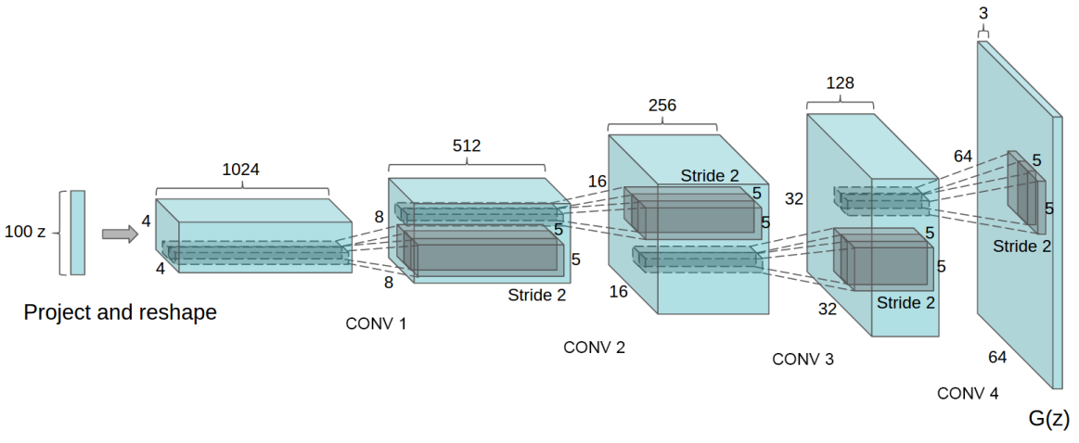
DCGANS

Slide 23
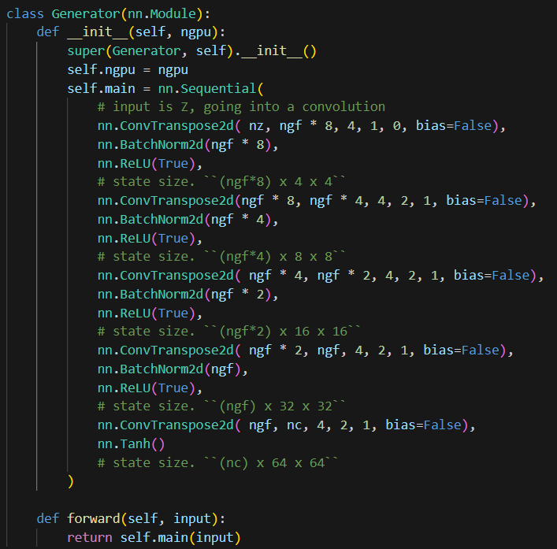

Slide 24
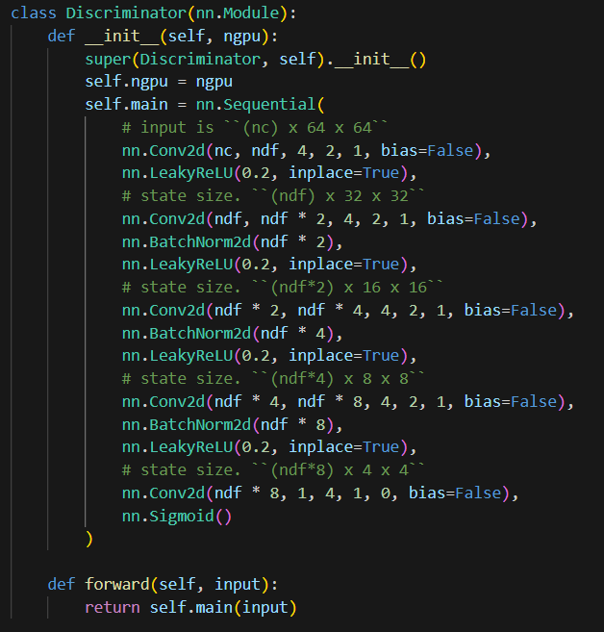

Slide 25
DETAILS OF ADVERSARIAL TRAINING
We trained DCGANs on three datasets:
Large-scale Scene Understanding (LSUN)
Imagenet-1k
Faces dataset.
No pre-processing was applied to training images besides scaling to the range of the tanh activation function [-1, 1].
LeakyReLU with the slope of the leak was set to 0.2.
Adam optimizer with tuned hyperparameters.
Learning rate set to 0.0002

Slide 26
Image De-duplication Process
It is a method used to decrease the likelihood that GAN memorizes and directly replicates its training images
Model learns to understand and recreate the underlying data distribution without copying exact details.
Before deduplication, images from the training set are modified by cropping them to focus on the central region and then resizing them to a standard size of 32x32 pixels.
3072-128-3072 de-noising dropout regularized RELU autoencoder is used
Hidden code layer with 128 nodes.

Slide 27
Image De-duplication Process
Autoencoder compresses and then reconstructs the images, helping to remove noise and unnecessary details.
Binarization and semantic hashing:
After training, the latent spaces are used to represent each image.
Z are made binary (0 or 1) by thresholding: values above the threshold are set to 1, and those below are set to 0.
Result of binarization is like semantic hashing where similar images are likely to have similar binary codes, allowing for efficient comparison and deduplication.

Slide 28
Image De-duplication Process
De-duplication
Using these binary codes images are compared and deduplicated.
Visual inspection and hash collisions: The authors manually inspected cases where different images had the same binary code (hash collisions).
The technique effectively identified and removed about 275,000 near-duplicate images from the dataset

Slide 29
DCGANS
Convolutional Layers: DCGANs use convolutional layers (in the discriminator) and transpose convolutional layers (in the generator)
Working Process:
The generator creates images from random noise.
The discriminator assesses these images and real images from the dataset, trying to distinguish between the two.
The output of the discriminator is a probability score that represents how likely it is that the image is real.

Slide 30
Training of DCGANs
Training the Discriminator:
In each training step, the discriminator is trained first.
It is provided a batch of real images (labeled as real) and a batch of fake images generated by the generator (labeled as fake).
The goal is to maximize the probability of correctly classifying both real and fake images.
Training the Generator:
After updating the discriminator, the generator is trained.
It generates a batch of images, which are then passed to the discriminator.
The generator's goal is to minimize the likelihood that the discriminator correctly identifies the images as fake (Adversarial).

Slide 31
Training of DCGANs
Adversarial Process:
As training progresses, the generator improves in generating realistic images, the discriminator must also improve at distinguishing fake images from real ones, and vice versa.
This competition drives both networks to improve (adversarial).
Backpropagation and Optimization:
Both networks use backpropagation to update their weights.
This iterative process of alternating between training the discriminator and the generator continues until a stopping criterion is met (like a fixed number of epochs or a desired level of performance).
Loss Functions:
Commonly used loss functions include binary cross-entropy
The generator’s loss is based on how well it tricks the discriminator.

Slide 32
Key Features
Stability:
DCGANs often offer more stable training compared to traditional GANs, partly due to their convolutional nature.
Hyperparameters:
Tuning hyperparameters (like learning rates, batch size, etc.) is crucial for effective training.
Mode Collapse:
A common issue with GANs, including DCGANs, is mode collapse, where the generator produces limited varieties of outputs.

Slide 33
Key challenges
Some strategies to mitigate Mode collapse:
Adding Noise to Inputs:
Introducing noise to the inputs of the discriminator can prevent the discriminator from becoming too confident.
This uncertainty can prevent the generator from exploiting weaknesses in the discriminator, leading to a more stable and diverse output.
Regularization Techniques:
Applying regularization methods like gradient penalty or weight normalization can help in stabilizing the training and thus prevent mode collapse.
Using Different Architectures or Loss Functions:
Sometimes, simply changing the architecture of the GAN or using a different loss function can mitigate mode collapse.
Conditional GANs

Slide 34
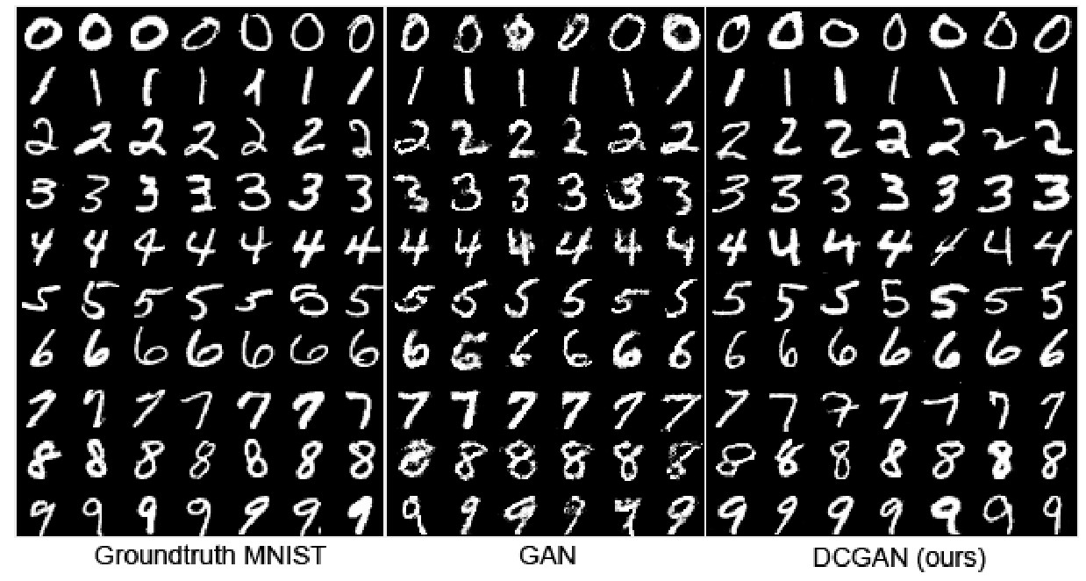
DCGANs Results

Slide 35
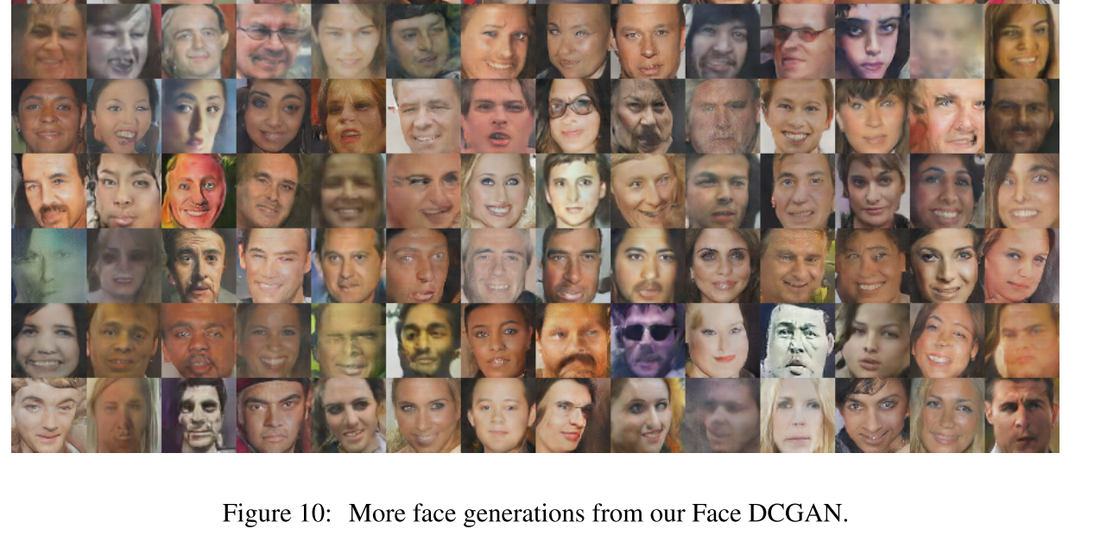
DCGANs Results

Slide 36
Guidelines for DCGANs
Architecture guidelines for stable Deep Convolutional GANs
Replace any pooling layers with strided convolutions (discriminator) and fractional-strided convolutions (generator).
Use Batchnorm in both the generator and the discriminator.
Remove fully connected hidden layers for deeper architectures.
Use ReLU activation in generator for all layers except for the output, which uses Tanh.
Use LeakyReLU activation in the discriminator for all layers.

Slide 37
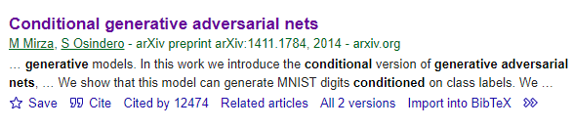
Conditional Generative Adversarial Nets Conditional GANs

Slide 38
Conditional GANs
Conditional Generative Adversarial Nets (Conditional GANs) are an extension of the original Generative Adversarial Networks (GANs) framework
It incorporates conditional information into the data generation process.
Both the generator and discriminator are provided with additional conditional data
class labels or part of data features
This allows the generated data to be more specific to the given condition
More controlled and diverse data generation.

Slide 39
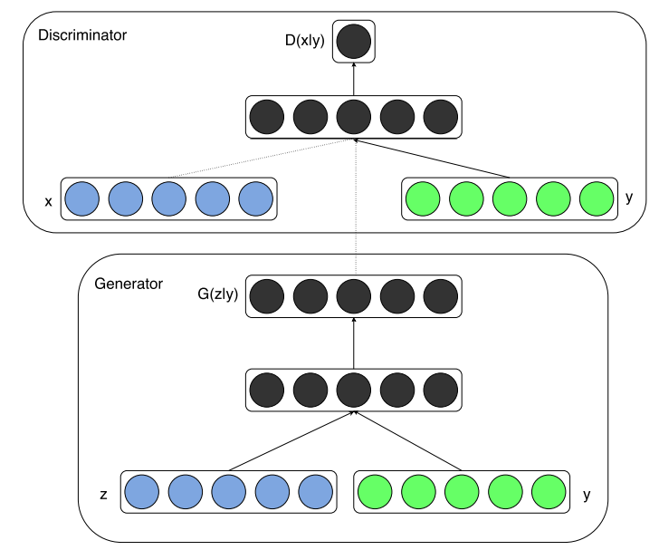
Conditional GANs

Slide 40
Conditional GANs
Input with Condition:
Both the generator and the discriminator receive additional conditional information y.
This could be a one-hot encoded vector representing class labels, text descriptions, or any other form of auxiliary data.
Generator:
The generator G takes a noise vector z and conditional information y to produce data G(z|y)
Not only produces realistic output but also matches the given condition.

Slide 41
Conditional GANs
Discriminator:
The discriminator ( D ) also receives the conditional information y alongside the real data or the generated data from the generator.
Its task is to determine whether the given data is real or fake and whether it corresponds to the given condition.
The discriminator assesses D(x, y), where ( x ) is either real or generated data.
Objective Function:
The loss function encourages the generator to create data that can fool the discriminator into believing it is real and correctly conditioned.
Distinguish between real and fake data and also ensure that the generated data adheres to the conditional context.

Slide 42


Conditional GANs
The conventional GANs define the objective function as:
Conditional GANs the objective function now becomes:

Slide 43
Conditional GANs
Backpropagation and Training:
The networks are trained using backpropagation and gradient descent methods.
The generator and discriminator are trained alternately: the discriminator is trained by showing it real data with the correct condition and fake data with the intended condition, while the generator is trained to produce data that the discriminator will think is real.
Learning Conditional Distributions:
Over time, the generator learns to produce data that is conditioned on the additional information, effectively learning the conditional distribution of the data.
The discriminator gets better at evaluating the authenticity of the data and its alignment with the given condition.

Slide 44
Conditional GANs
Diverse and Controlled Generation:
By conditioning on different y, the generator can produce diverse results tailored to specific conditions, providing more control over the data generation process.

Slide 45
Conditional GANs
Use cases:
Image-to-image translation
Object reconstruction from edges, photo synthesis from label maps, and image colorization.
Creating images from text
Create high-quality photos based on text.
Video generation
Predict future frames of a video based on a selection of previous images.
Face generation
Generate images of faces with specific attributes, such as hair or eye color, simile etc.

Slide 46
Conditional GAN Experimental Results: Unimodal
Trained a conditional adversarial net on MNIST images conditioned on their class labels, encoded as one-hot vectors.
In the generator net, a noise prior z with dimensionality 100 was drawn from a uniform distribution
Both z and y are mapped to hidden layers with Rectified Linear Unit (ReLu) activation with layer sizes 200 and 1000 respectively
Combined both Z and Y and fed to 2nd hidden layer with ReLu of dimensionality 1200.
Final sigmoid unit layer as our output for generating the 784-dimensional MNIST samples.

Slide 47
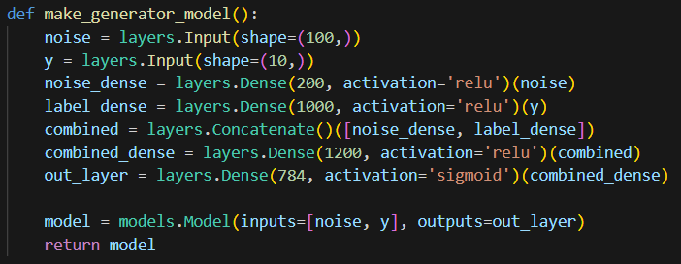
Conditional GAN Experimental Results: Unimodal

Slide 48
Conditional GAN Experimental Results: Unimodal
Discriminator:
The discriminator maps x to a maxout layer with 240 units and 5 pieces
Y to a maxout layer with 50 units and 5 pieces.
Both of the hidden layers mapped to a joint maxout layer with 240 units and 4 pieces before being fed to the sigmoid layer.

Slide 49
Maxout layer
A Maxout layer works by dividing its inputs into groups (referred to as "pieces") and outputting the maximum value within each group.
If a Maxout layer has, say, 240 units and is described to have 5 pieces, this means each unit takes 5 inputs and outputs the maximum of these inputs.
This approach helps the network learn more complex functions compared to traditional units and improves the model's capacity to handle non-linear phenomena without relying on predefined activation functions like ReLU or sigmoid.

Slide 50
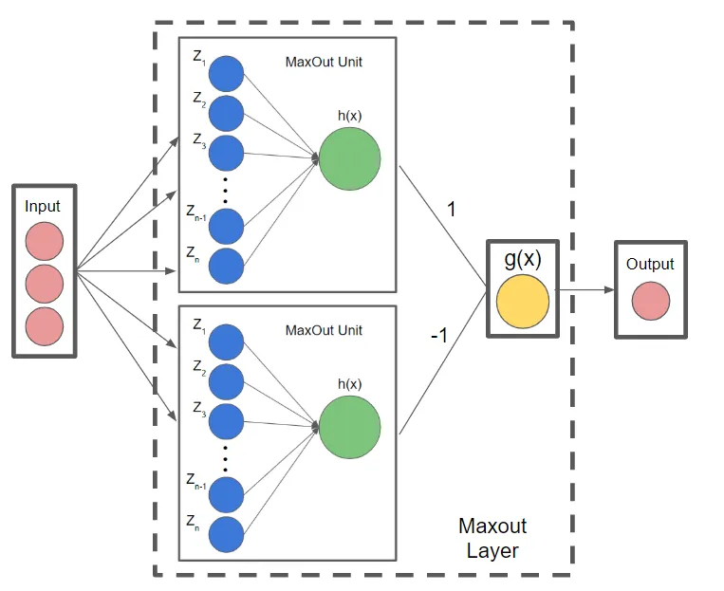
Maxout layer

Slide 51
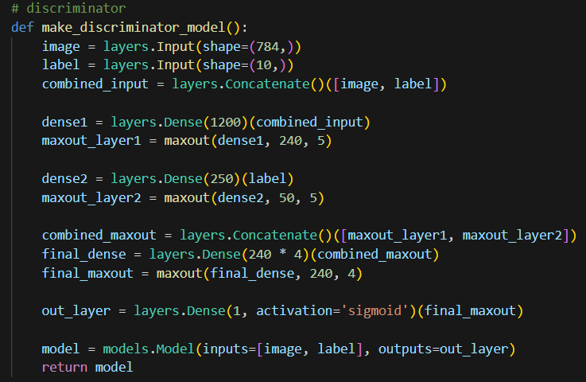
Conditional GAN Experimental Results: Unimodal

Slide 52
Image-to-Image Translation with Conditional GANs
Image-to-Image Translation with Conditional Adversarial Networks
Download Paper: https://arxiv.org/pdf/1611.07004v3.pdf
Paper Code: https://github.com/phillipi/pix2pix
Conditional adversarial networks as a general-purpose solution to image-to-image translation problems
This approach is effective at synthesizing photos from label maps, reconstructing objects from edge maps, and colorizing images
pix2pix software

Slide 53
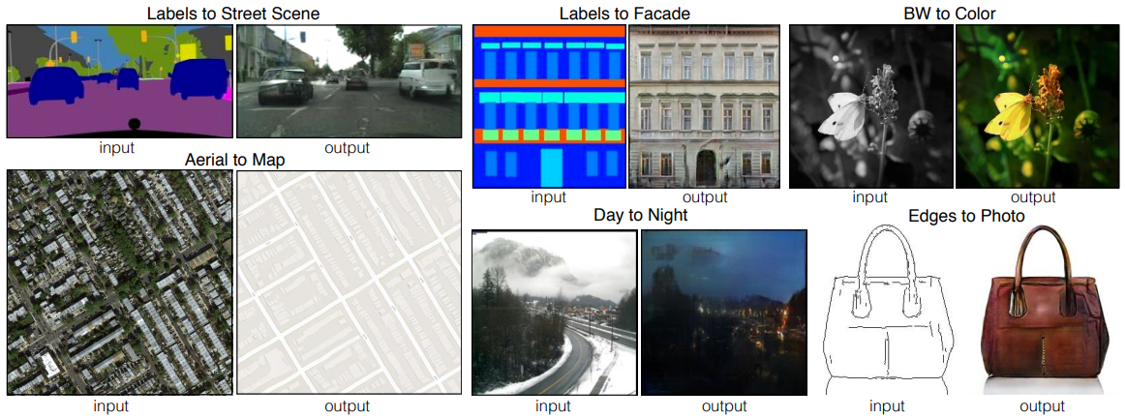
Image-to-Image Translation with Conditional GANs

Slide 54
Image-to-Image Translation with Conditional GANs
Many image processing and computer vision can be posed as “translating” problems
Translate an input image into a corresponding output image.
Similar to translating English or French
A scene may be rendered as an RGB image, an edge map, a semantic label map, etc.
We define automatic image-to-image translation as the task of translating one possible representation of a scene into another
Need sufficient training data

Slide 55
Image-to-Image Translation with Conditional GANs
In this paper, GANs are used in the conditional setting.
GANs learn a generative model of data, conditional GANs (cGANs) learn a conditional generative model.
This makes cGANs suitable for image-to-image translation tasks, where we condition on an input image and generate a corresponding output image

Slide 56
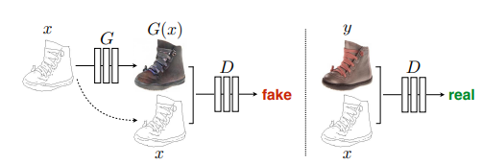
Image-to-Image Translation with Conditional GANs
Training a conditional GAN to map edges→photo.

Slide 57

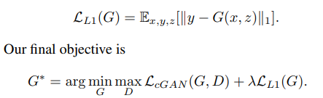
Image-to-Image Translation with Conditional GANs
Objective:
The objective of a conditional GAN can be expressed as

Slide 58
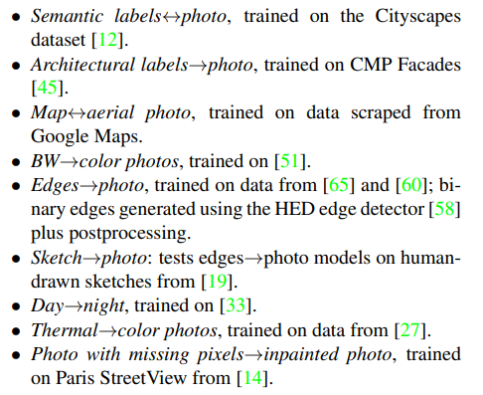
Image-to-Image Translation with Conditional GANs

Slide 59
References
Conditional Generative Adversarial Nets Conditional GANs
Image-to-Image Translation with Conditional Adversarial Networks

Slide 60
Thank You ☺

